Slide 1

Hotel reservation analysis: SQL

Slide 2
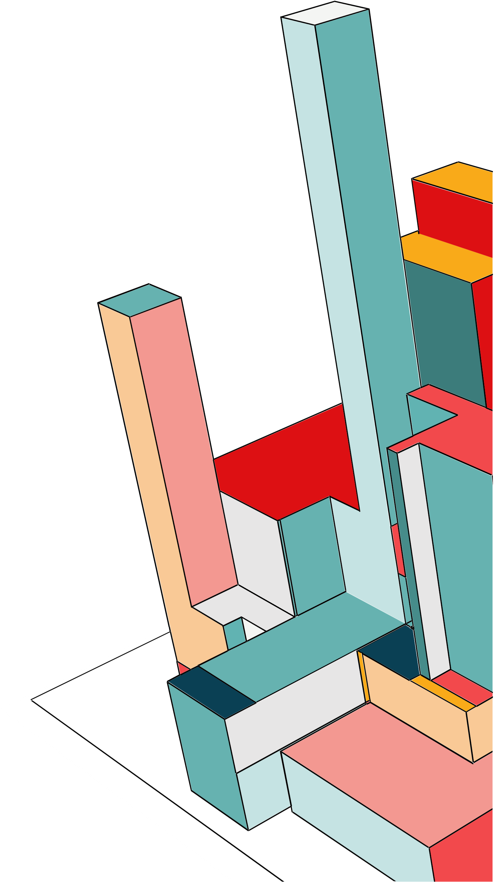
Overview
The hotel industry relies on data to make informed decisions and provide a better guest experience.
In this project, I will work with a hotel reservation dataset to gain insights into guest preferences, booking trends, and other key factors that impact the hotel's operations.
I will use SQL to query and analyse the data, as well as answer specific questions about the dataset.

Slide 3
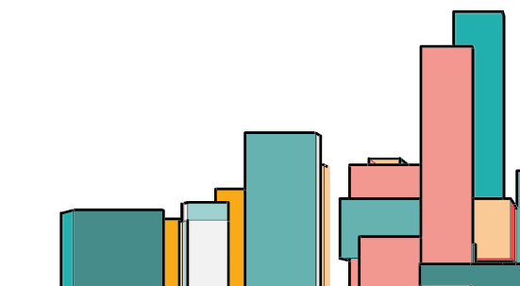
What does good look like?
1. What is the total number of reservations in the dataset?
2. Which meal plan is the most popular among guests?
3. What is the average price per room for reservations involving children?
4. How many reservations were made for the year 20XX (replace XX with the desired year)?
5. What is the most commonly booked room type?
6. How many reservations fall on a weekend (no_of_weekend_nights > 0)?
7. What is the highest and lowest lead time for reservations?
8. What is the most common market segment type for reservations?
9. How many reservations have a booking status of "Confirmed"?
10. What is the total number of adults and children across all reservations?
11. What is the average number of weekend nights for reservations involving children?
12. How many reservations were made in each month of the year?
13. What is the average number of nights (both weekend and weekday) spent by guests for each room
type?
14. For reservations involving children, what is the most common room type, and what is the average
price for that room type?
15. Find the market segment type that generates the highest average price per room.

Slide 4
1 What is the total number of reservations in the dataset?
use internship_1stproject;
SELECT * FROM `hotel reservation dataset`;
SELECT count(Booking_ID) as reserved FROM `hotel reservation dataset` ;
Output:
reserved
700

Slide 5
2. Which meal plan is the most popular among guests?
SELECT type_of_meal_plan, count(type_of_meal_plan) as favourite_meal from `hotel reservation dataset`
group by 1 order by 2 desc;
Type_of_meal_plan | Favourite_meal
Meal Plan 1 | 527
Not Selected | 109
Meal Plan 2 | 64

Slide 6
3. What is the average price per room for reservations involving children?
SELECT avg(avg_price_per_room) from `hotel reservation dataset` where no_of_children >0 order by 1 desc;
avg_price_per_room
144.56833333333336

Slide 7
4. How many reservations were made for the year 20XX (replace XX with the desired year)?
SELECT COUNT(arrival_date) AS reservations_count FROM `hotel reservation dataset`
WHERE YEAR(STR_TO_DATE(arrival_date, '%d-%m-%Y')) = 2018;
reservations_count
577

Slide 8
5. How many reservations fall on a weekend (no_of_weekend_nights > 0)?
SELECT count(Booking_ID) from `hotel reservation dataset` where no_of_weekend_nights > 0;
Reservations_weekend
383

Slide 9
6. What is the most commonly booked room type?
SELECT room_type_reserved, COUNT(*) from `hotel reservation dataset` group by 1 order by 2 desc limit 1
Room_type_reserved | count
Room_type_1 | 534

Slide 10
7. What is the highest and lowest lead time for reservations?
select max(lead_time),min(lead_time) from `hotel reservation dataset`;
max(lead_time), | min(lead_time),
443 | 0

Slide 11
8. What is the most common market segment type for reservations?
select count(market_segment_type),market_segment_type from `hotel reservation dataset` group by 2 order by 1 desc limit 1;
Count(market_segment_type) | market_segment_type
518 | Online

Slide 12
9. How many reservations have a booking status of "Confirmed"?
SELECT count(Booking_ID) as reserved FROM `hotel reservation dataset` where booking_status='Not_Canceled’;
reserved
493

Slide 13
10. What is the total number of adults and children across all reservations?
select sum(no_of_adults) as adults,sum(no_of_children) as children from `hotel reservation dataset` where no_of_adults>0 and no_of_children>0;
adults | children
87 | 63

Slide 14
11. What is the average number of weekend nights for reservations involving children?
select avg(no_of_weekend_nights) as weekend from `hotel reservation dataset` where no_of_children>0;
Avg_no_of_weekend
1000

Slide 15
11. What is the average number of weekend nights for reservations involving children?
select avg(no_of_weekend_nights) as weekend from `hotel reservation dataset` where no_of_children>0;
Avg_no_of_weekend
1000

Slide 16
12. How many reservations were made in each month of the year?
SELECT YEAR(STR_TO_DATE(arrival_date, '%d-%m-%Y')) AS year,
MONTH(STR_TO_DATE(arrival_date, '%d-%m-%Y')) AS month,
COUNT(*) AS reservations_countFROM `hotel reservation dataset`
GROUP BY year, month order BY year, month;
year | month | Count_of_reservation
2017 | 7 | 8
2017 | 8 | 14
2017 | 9 | 35
2017 | 10 | 40
2017 | 11 | 13
2017 | 12 | 13
2018 | 1 | 11
2018 | 2 | 28
2018 | 3 | 52
2018 | 4 | 67
2018 | 5 | 55

Slide 17
13. What is the average number of nights (both weekend and weekday) spent by guests for each room type?
select distinct room_type_reserved,avg(no_of_weekend_nights) over(partition by room_type_reserved) as weekend , avg(no_of_week_nights) over(partition by room_type_reserved) as weekdays from `hotel reservation dataset` ;
Room_type | Weekend | Weekdays
Room_Type 1 | 0.7884 | 2.0899
Room_Type 2 | 1.0000 | 2.0000
Room_Type 4 | 1.0923 | 2.7077
Room_Type 5 | 0.0000 | 2.5000
Room_Type 6 | 1.0556 | 2.5556
Room_Type 7 | 1.0000 | 1.6667

Slide 18
14. For reservations involving children, what is the most common room type, and what is the average price for that room type?
with cte as ( select count(room_type_reserved) as room_cnt,room_type_reserved,avg(avg_price_per_room) as average_price from `hotel reservation dataset`
where no_of_children>0 group by 2 order by 1 desc )
select room_type_reserved, room_cnt, average_price from cte order by room_cnt desc limit 1;
room_type_reserved | room_cnt | average_price
Room_Type 1 | 0.7884 | 2.0899
Room_Type 2 | 1.0000 | 2.0000
Room_Type 4 | 1.0923 | 2.7077
Room_Type 5 | 0.0000 | 2.5000
Room_Type 6 | 1.0556 | 2.5556
Room_Type 7 | 1.0000 | 1.6667

Slide 19
15. Find the market segment type that generates the highest average price per room.
select market_segment_type,avg(avg_price_per_room) from `hotel reservation dataset` group by 1 order by 2 desc
market_segment_type | avg_price_per_room
Online | 112.45521235521232
Aviation | 110
Offline | 89.98171428571426
Corporate | 82.4011111111111
Complementary | 2.5357142857142856

Slide 20

THANKYOU

